Slide 1
Group Members
Zehra
Syeda Roqia

Slide 2
Online Store
“Your Style, Your Store, Online”

Slide 3
Overview
Introduction
Requirement
Feasibility
Design
Screen Shots
Future Scope
Conculsion

Slide 4
Online Store
An online store, also known as an e-commerce store or electronic commerce store, is a website or digital platform that allows businesses to sell their products or services over the internet

Slide 5
Homepage
It contains Categories
Fashion
Beauty
Kids
Reading

Slide 6
Our Header Contain
Home Page
Customer Care
Sign Up page
Sign In Page

Slide 7
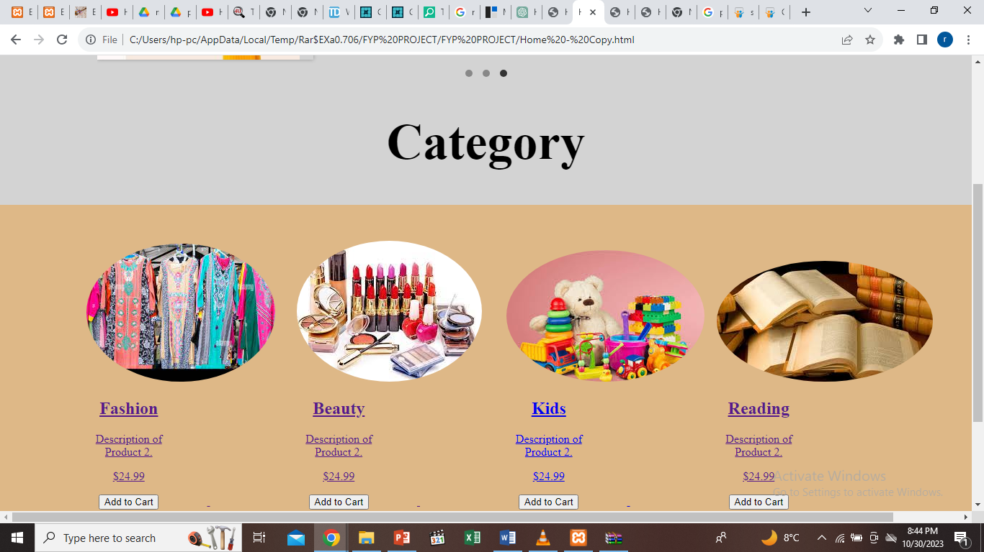
categories

Slide 8
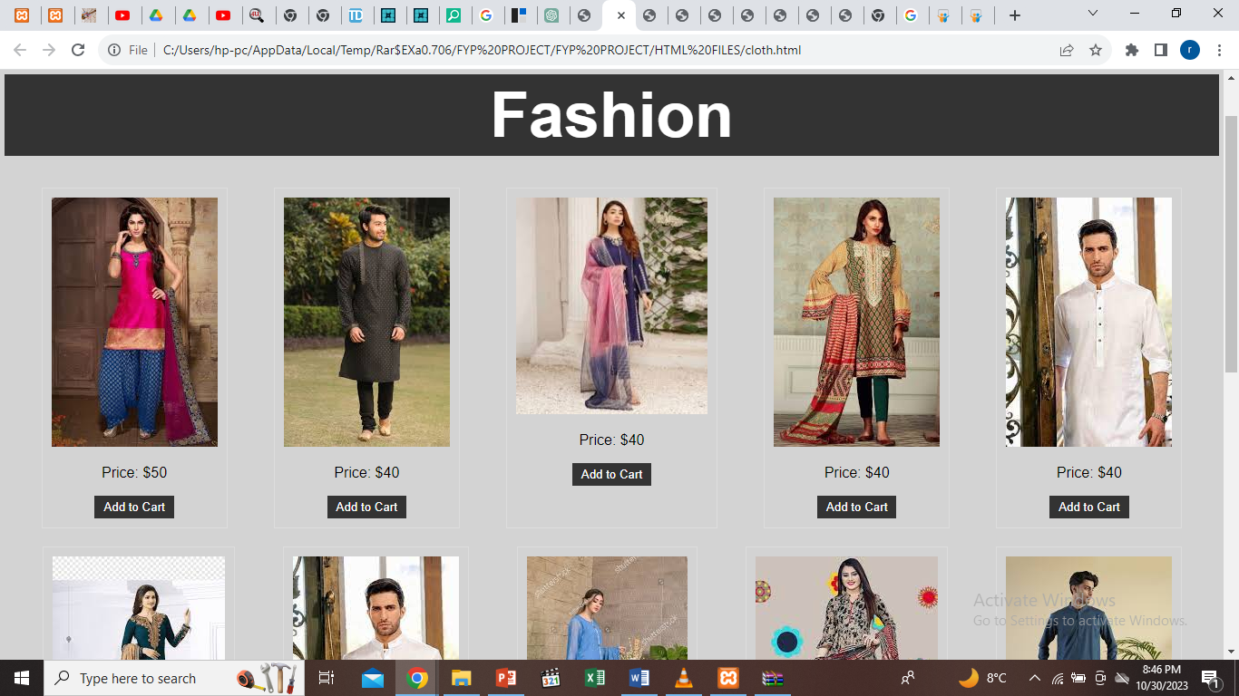
Fashion

Slide 9
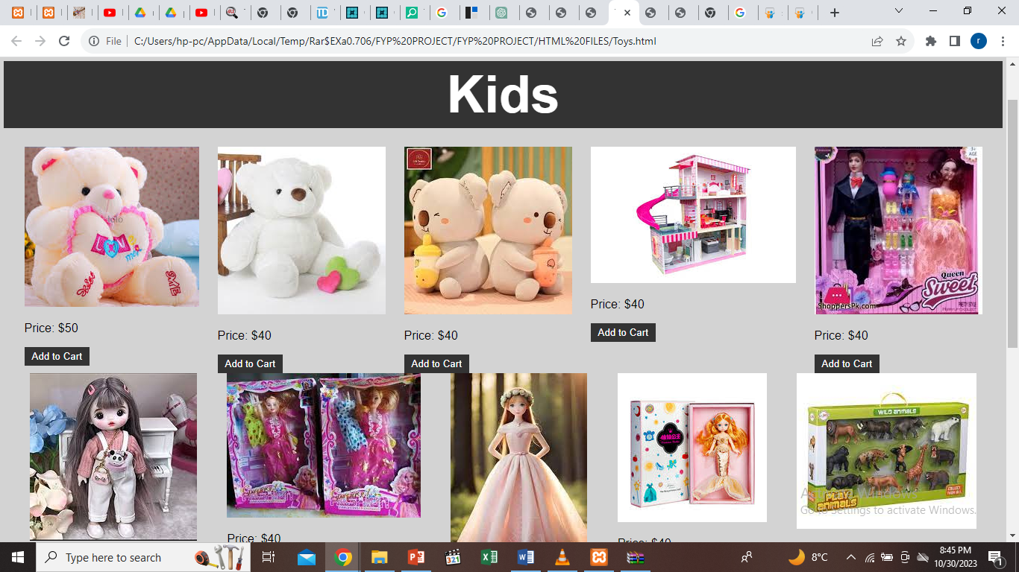
Kids

Slide 10
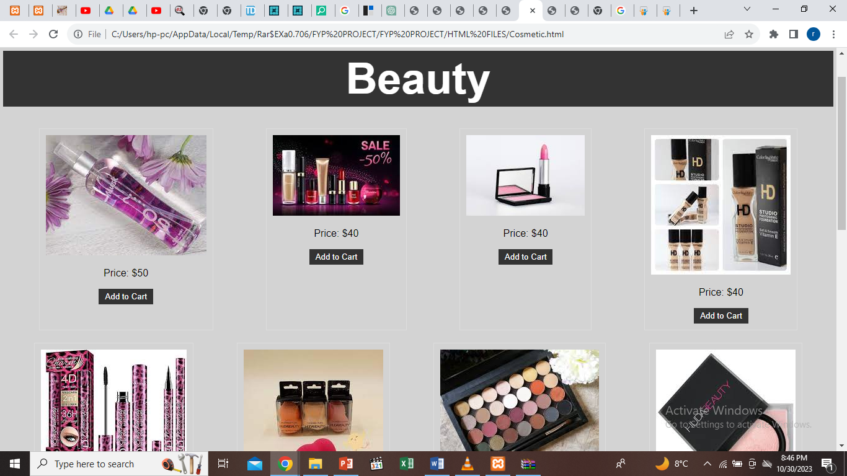
Beauty

Slide 11
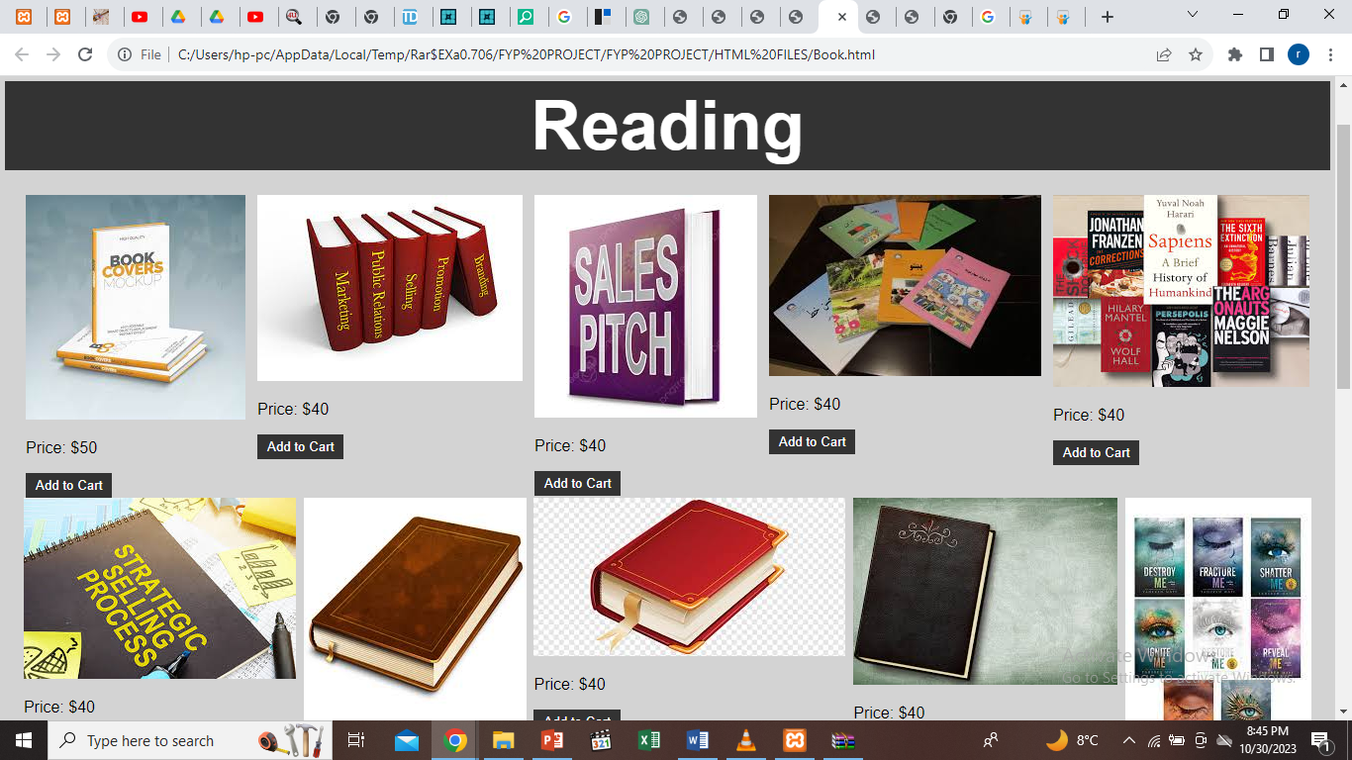
Reading

Slide 12
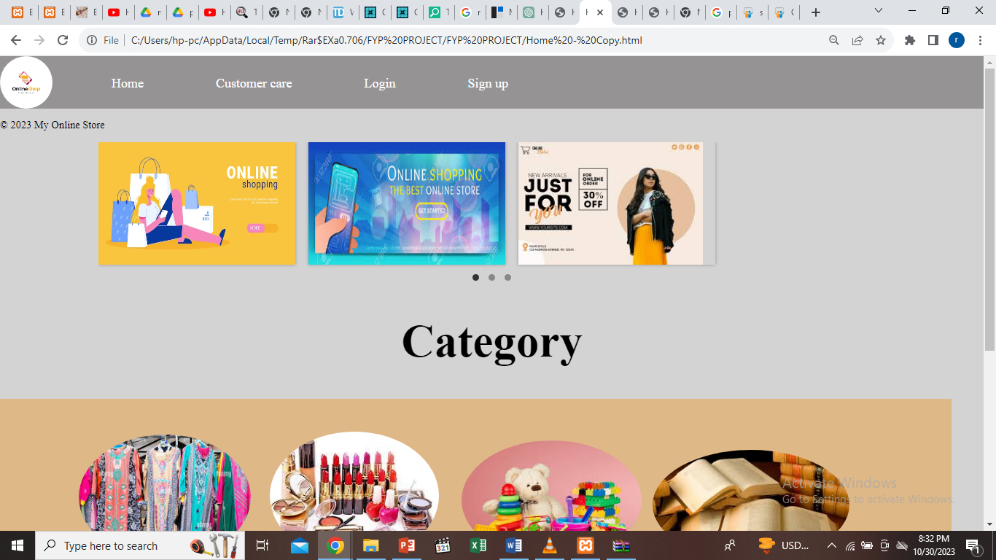
Home page

Slide 13
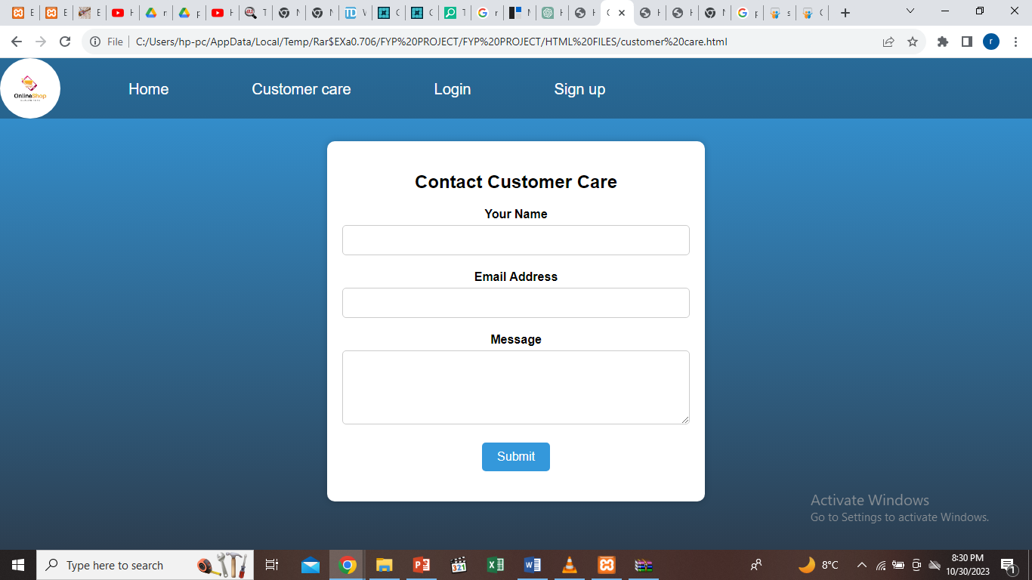
Customer Care

Slide 14
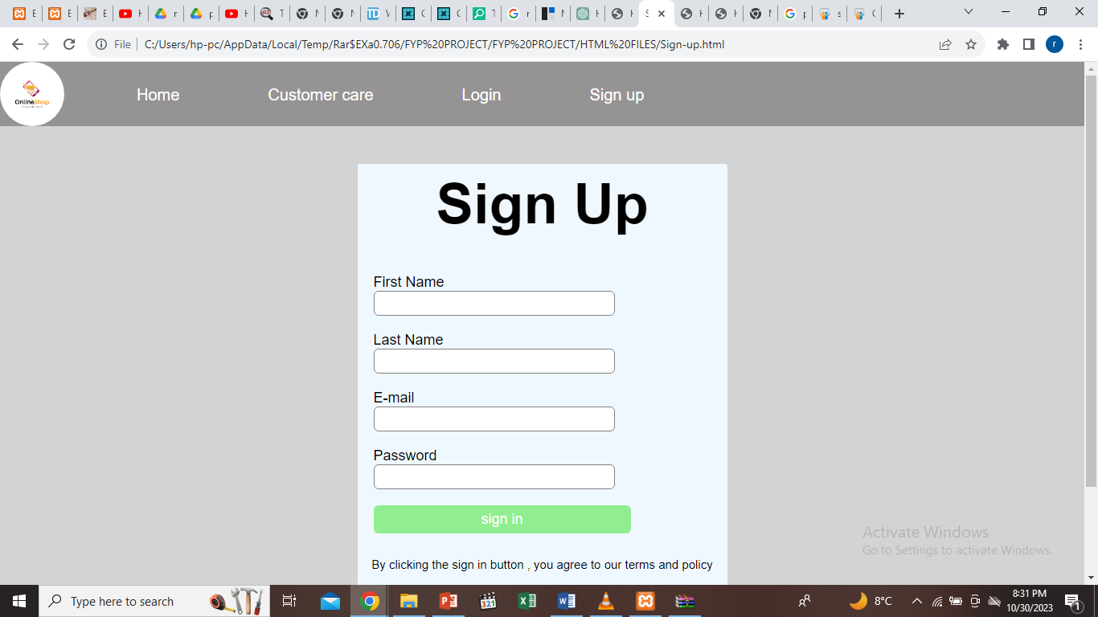
Sign Up

Slide 15
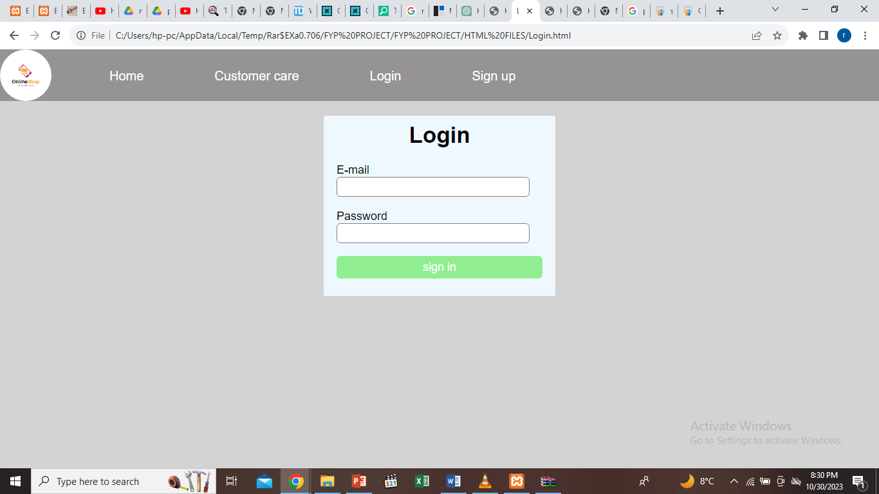
Sign In

Slide 16
Feasibility
Technically , this project is very feasible because of use of current and latest techniques.
Financially, It is also very feasible it made up in very low cost and will be free for all customers
It is very easy to use because almost have smartphones

Slide 17
Requirements
Smart Phone
Internet
Preferable digital accounts like easy paisa.

Slide 18
Tools and Technology
HTML and CSS
JavaScript
Visual Studio

Slide 19
Future Scope
The project made here is just to ensure that this product could be valid in today real challenging world.
Currently it is not visible on virtual world because of some limitations of project. In future it may be there.

Slide 20
Conclusion
Online shopping is the best way to purchase and sell any item but careful because there may be some fake products on different sites.
Purchase those products whose rating is good

